Slide 1

Non Functional aspects of web
Aruna S
Department of
Computer Science and Engineering

Slide 2

Non functional aspects of web
Cross Site Scripting
S. Aruna
Department of Computer Science and Engineering

Slide 3
XSS
Introduction
Cross-Site Scripting (also commonly known as XSS) is a vulnerability/flaw that combines the allowance of html/script tags as input that are rendered into a browser without encoding or sanitization
Cross-Site Scripting (XSS) is the most prevalent and pernicious web application security issue. While there is a simple well-known defense for this attack, there are still many instances of it on the web.
In terms of fixing it, coverage of fixes also tends to be a problem. We will talk more about the defense in a little bit

Slide 4
XSS
XSS - Impact
Especially as 'Rich Internet Applications' are more and more common place, privileged function calls linked to via JavaScript may be compromised.
And if not properly protected, sensitive data (such as your authentication cookies) can be stolen and used for someone else’s purpose.
Quick examples:
From the JavaScript console in the developer tools of the browser (chrome, Firefox)
alert("XSS Test");
alert(document.cookie);
Any data field that is returned to the client is potentially injectable
<script>alert("XSS Test")</script>

Slide 5
XSS
XSS – Most Common Locations
Search fields that echo a search string back to the user
Input fields that echo user data
Error messages that return user supplied text
Hidden fields that contain user supplied data
Any page that displays user supplied data
Message boards
Free form comments
HTTP Headers

Slide 6
XSS
XSS – Consequences
Stealing session cookies
Creating false requests
Creating false fields on a page to collect credentials
Redirecting your page to a "non-friendly" site
Creating requests that masquerade as a valid user
Stealing of confidential information
Execution of malicious code on an end-user system (active scripting)
Insertion of hostile and inappropriate content
XSS attacks add validity to phishing attacks
A valid domain is used in the URL

Slide 7
XSS
Types of XSS
Reflected
Malicious content from a user request is displayed to the user in a web browser
Malicious content is written into the page after from server response
Social engineering is required
Runs with browser privileges inherited from user in browser
DOM-based (also technically reflected)
Malicious content from a user request is used by client-side scripts to write HTML to it own page
Similar to reflected XSS
Runs with browser privileges inherited from user in browser
Stored or persistent
Malicious content is stored on the server ( in a database, file system, or other object ) and later displayed to users in a web browser
Social engineering is not required

Slide 8
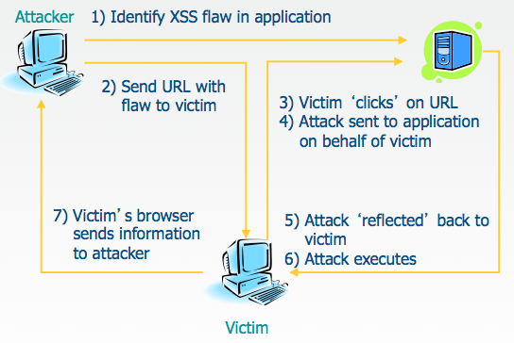
XSS
Reflected XSS
Attacker sends a malicious URL to victim
Victim clicks on the link that loads malicious web page
The malicious script embedded in the URL executes in the victim’s browser
T he script steals sensitive information, like the session id, and releases it to the attacker
Victim does not realize attack occurred

Slide 9
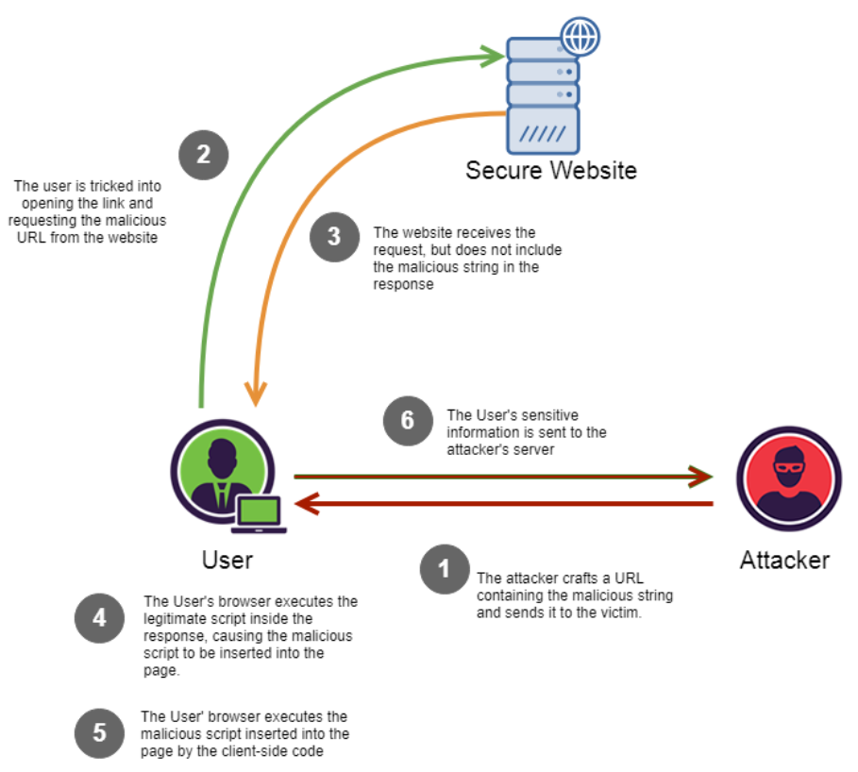
XSS
DOM based XSS
Malicious script does not reach to the web server. It is executed at client side only.DOM based XSS attack occurs when user provided untrusted data is interpreted as JavaScript using methods such as eval(), document.write or innerHTML. The main culprit for these type of attacks is JavaScript code.

Slide 10
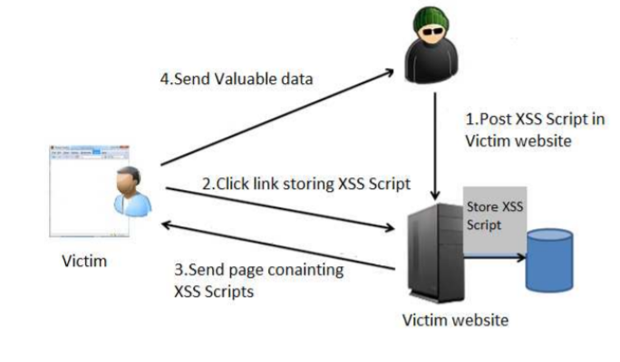
XSS
Persistent/Stored XSS
Malicious scripts injected by attacker are stored permanently by server in databases or webpages and served back to other users as normal pages coming from trusted application and user is interpreting them without proper HTML sanitization

Slide 11
XSS
Ways of Preventing XSS
1. Escaping
Escaping data means taking the data an application has received and ensuring it’s secure before rendering it
for the end user. By escaping user input, key characters in the data received by a web page will be prevented from
being interpreted in any malicious way .
3. Sanitizing
A third way to prevent cross-site scripting attacks is to sanitize user input. Sanitizing user input is especially
helpful on sites that allow HTML markup, to ensure data received can do no harm to users as well as your database
by scrubbing the data clean of potentially harmful markup, changing unacceptable user input to an acceptable format.
2. Validating Input
Validating input is the process of ensuring an application is rendering the
correct data and preventing malicious data from doing harm to the site, database, and users.

Slide 12
THANK YOU
Aruna S
Department of
Computer Science and Engineering
arunas@pes.edu

